Slide 1

VOICE RECOGNITION AND EMAIL BASED HOME AUTOMATION SYSTEM USING RASPBERRY PI
APURVA PANIDHAR 2210411204
DN GAURAV RAJ 1210411114
PATLURI SRI CHAITANYA 2210411246
SAHITHI MANAM 2210411252
UNDER THE GUIDANCE OF:
Mr. B. SAMMUNAYAK _{M.Tech}
ASSISTANT PROFESSOR
GITAM UNIVERSITY
HYDERABAD CAMPUS

Slide 2
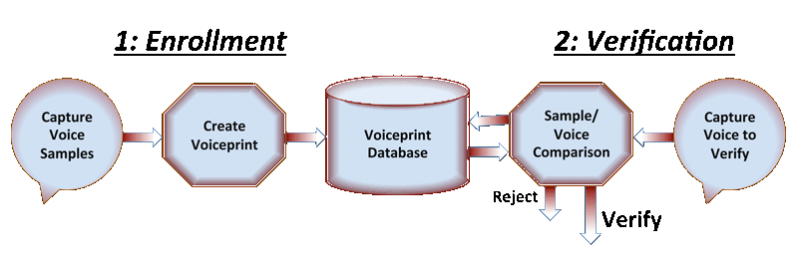
VOICE RECOGNITION
Voice or speech recognition is the ability of a machine or program to receive and interpret dictation, or to understand and carry out spoken commands.

Slide 3
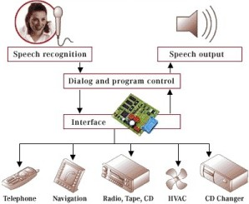
VOICE RECOGNITION SYSTEM
Enables user to control home appliances with voice commands when in the home
Implies that the system can only take dictation and not understand words
So you talk and your electronics listen!

Slide 4
POCKETSPHINX
PocketSphinx is a lightweight speech recognition engine.
A version of Sphinx that can be used in embedded systems like those based on an ARM processor.
Incorporates features such as fixed-point arithmetic and efficient algorithms for GMM computation.

Slide 5
FEATURES OF POCKETSPHINX
All the processing takes place on the Raspberry Pi, so it is capable of being used offline.
It supports real time speech recognition.
Pocketsphinx is resource-efficient.
Pocketsphinx supports many languages out-of box. It supports US English, Chinese, French, Russian, German, Dutch and more without need to train anything.
Pocketsphinx is completely free software.
Available bindings for several programming languages are present.

Slide 6
INSTALLATION
Setup and properly configure ALSA[Advanced Linux Sound Architecture].
Check your microphone is visible or not and if on which usb extension.
Download sphinxbase latest and extract it.
Download pocketsphinx and extract it.
Run it.

Slide 7
PYTHON CODE FOR TESTING VOICE RECOGNITION
#!/usr/bin/python
import time
import datetime
import math
import sys, select, subprocess
import os
proc = subprocess.Popen(['sh', '-c', 'pocketsphinx_continuous -adcdev hw:1,0 -nfft 2048 -samprate 48000 2>/dev/null'],stdout=subprocess.PIPE)
while True:
line = proc.stdout.readline()
if line != '':
output = line.rstrip()
print output
if (len(output.split("john"))>1):
os.system("sudo python home/pi/on.py")
if (len(output.split(“off"))>1):
os.system("sudo python home/pi/off.py")
if (len(output.split(“hi"))>1):
os.system("sudo python home/pi/five.py")
else:
break

Slide 8
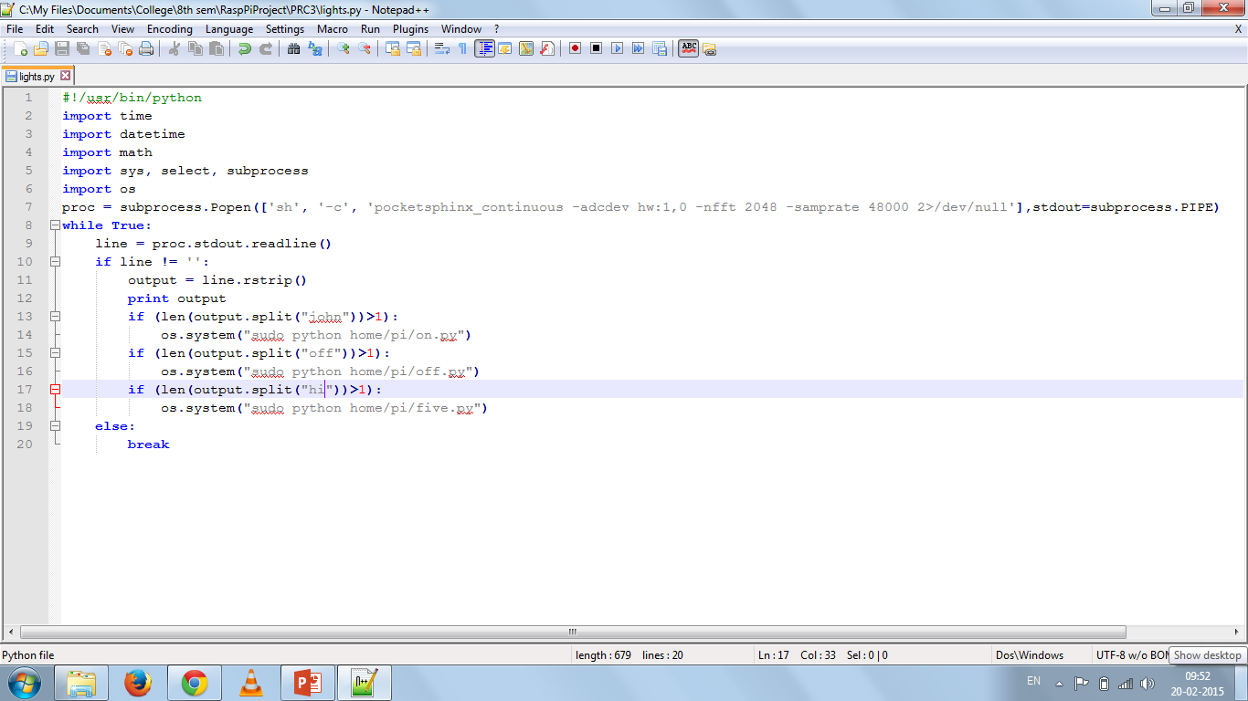

Slide 9
MODES OF OPERATION
Using the voice recognition software, we have operated the LED in 3 modes. They are:
1] On Mode
2] Off Mode
3] Blink Mode

Slide 10
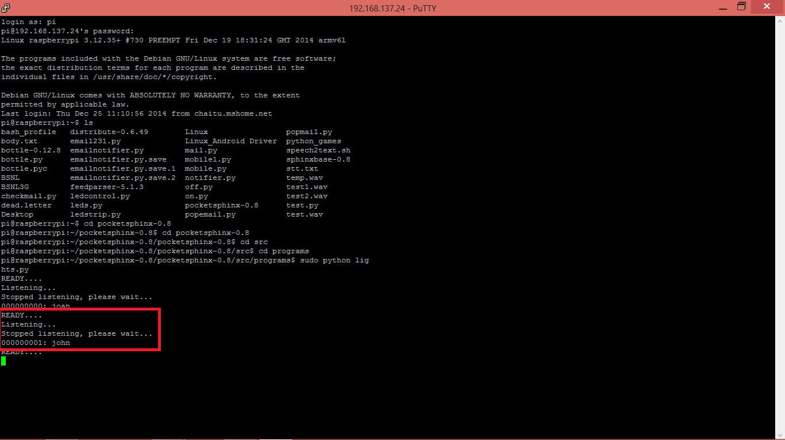
ON MODE

Slide 11
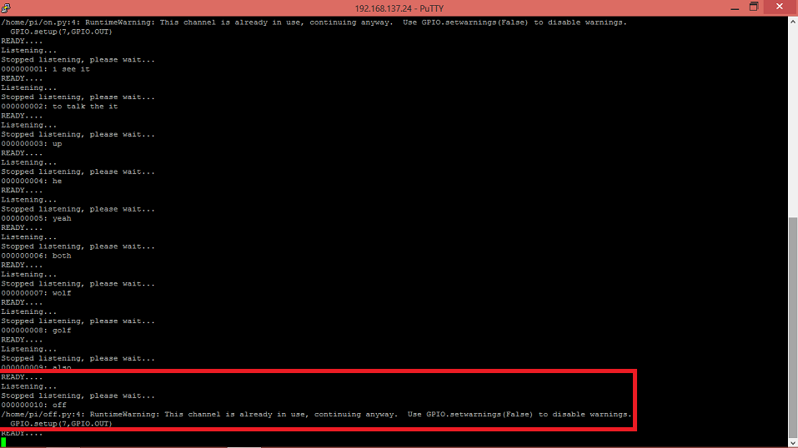
OFF MODE

Slide 12
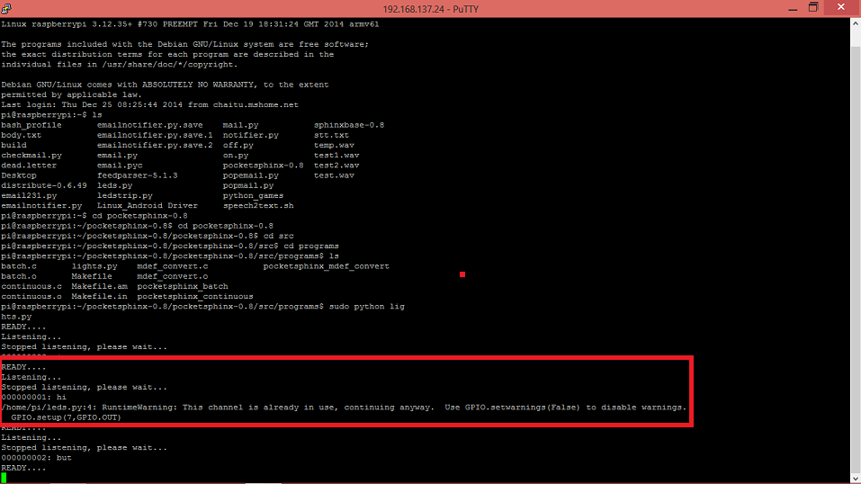
BLINK MODE

Slide 13
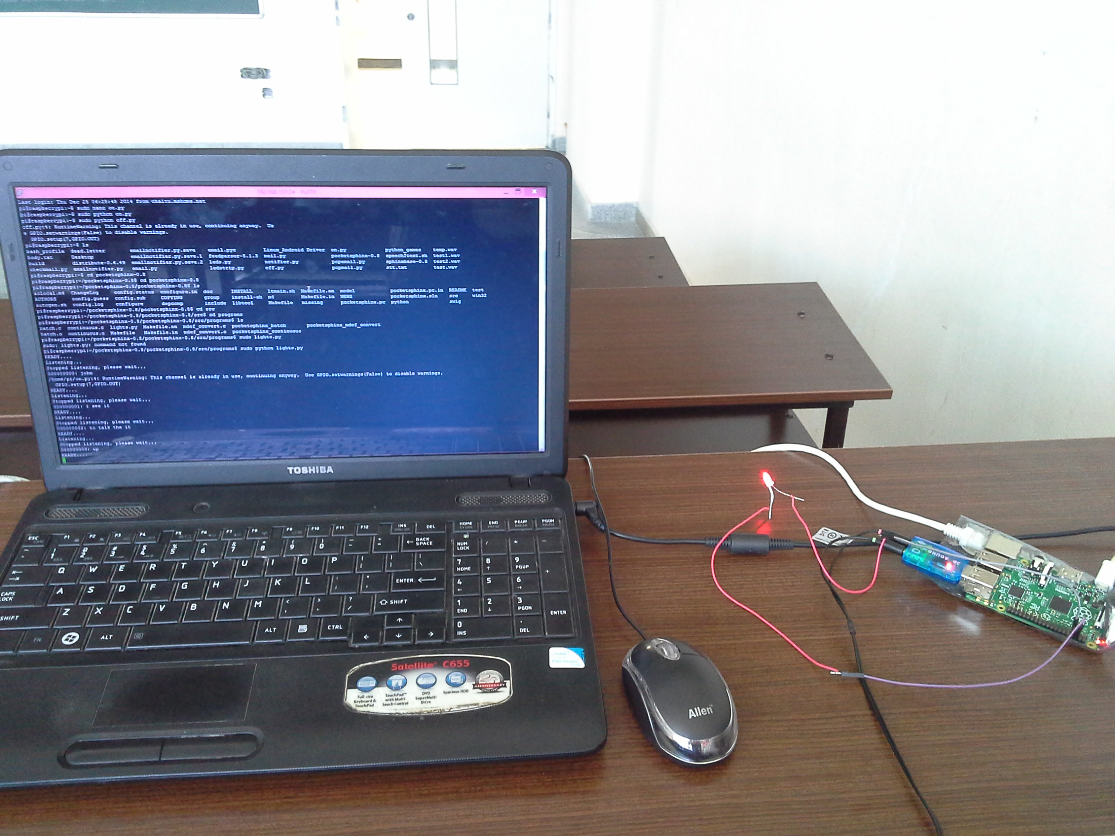
RESULTS 1-ON MODE

Slide 14
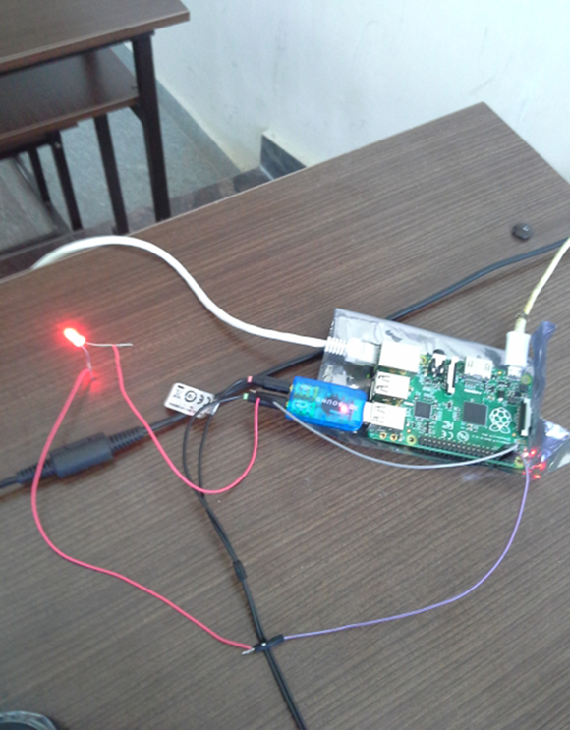

Slide 15
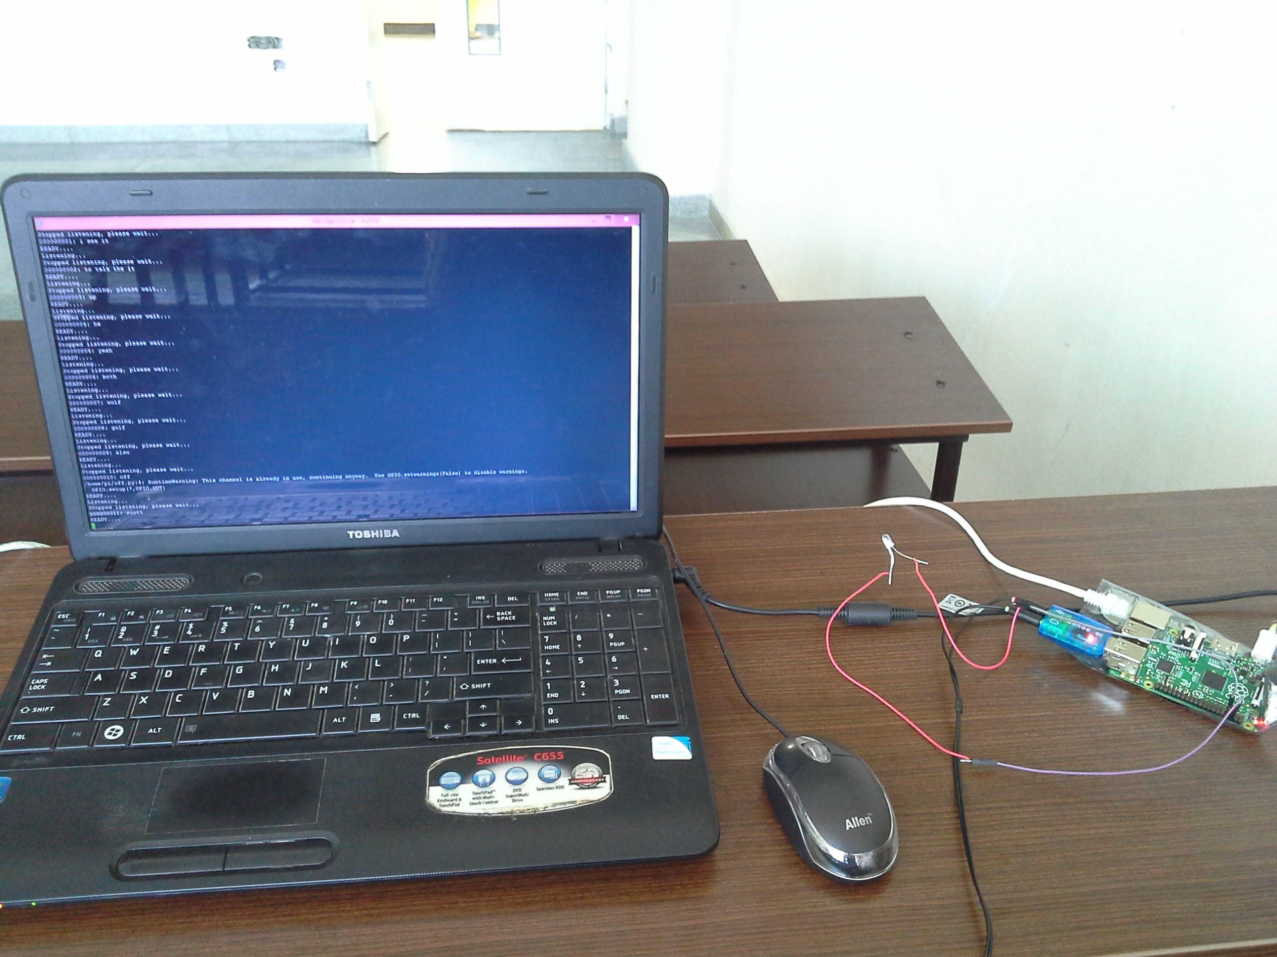
RESULTS 2-OFF MODE

Slide 16
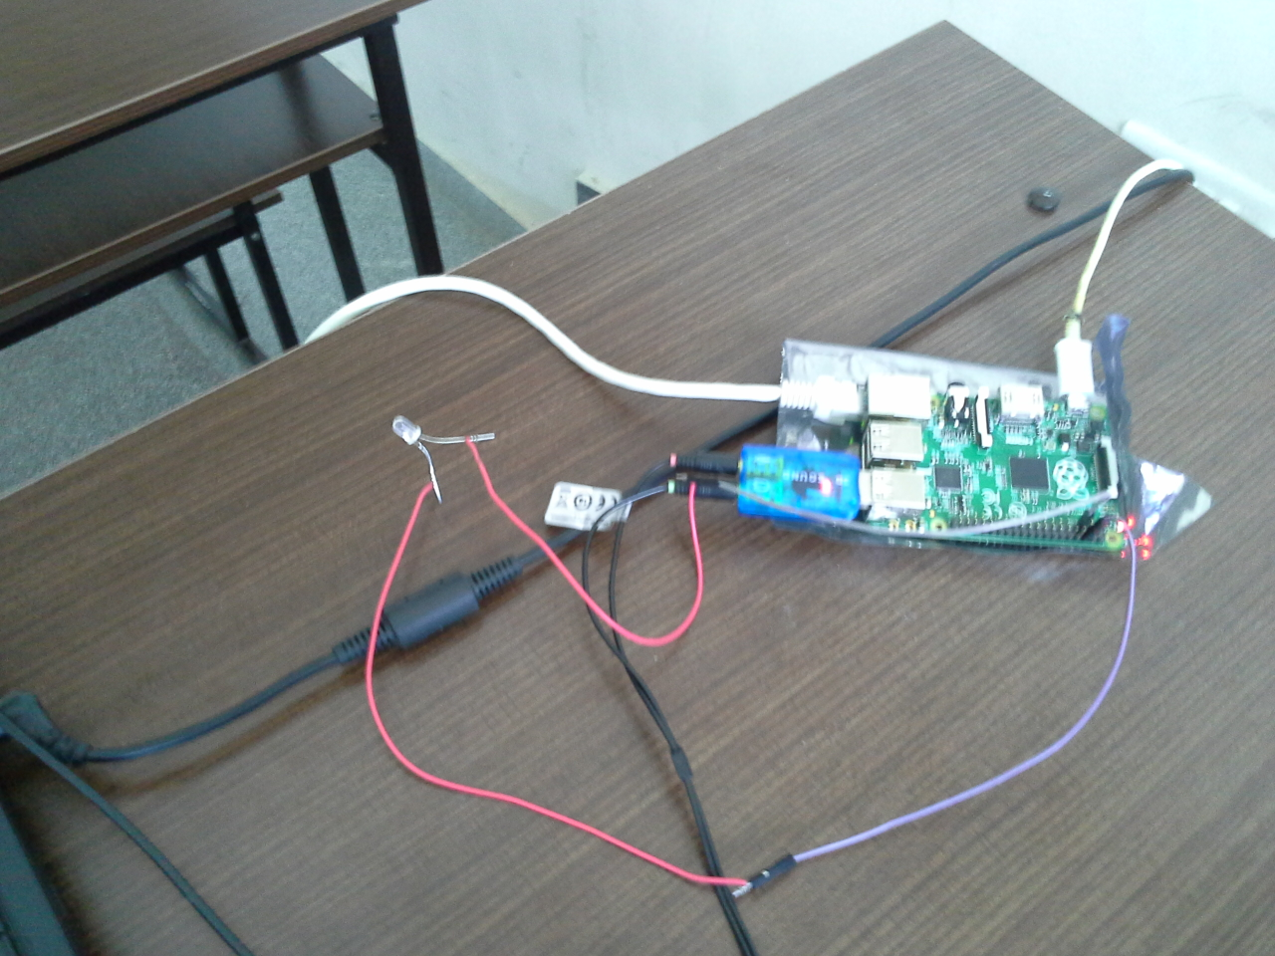

Slide 17
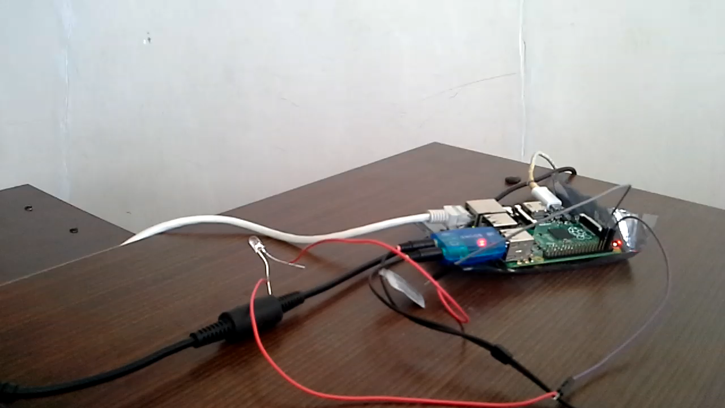
RESULTS 3-BLINK MODE

Slide 18


